Slide 1
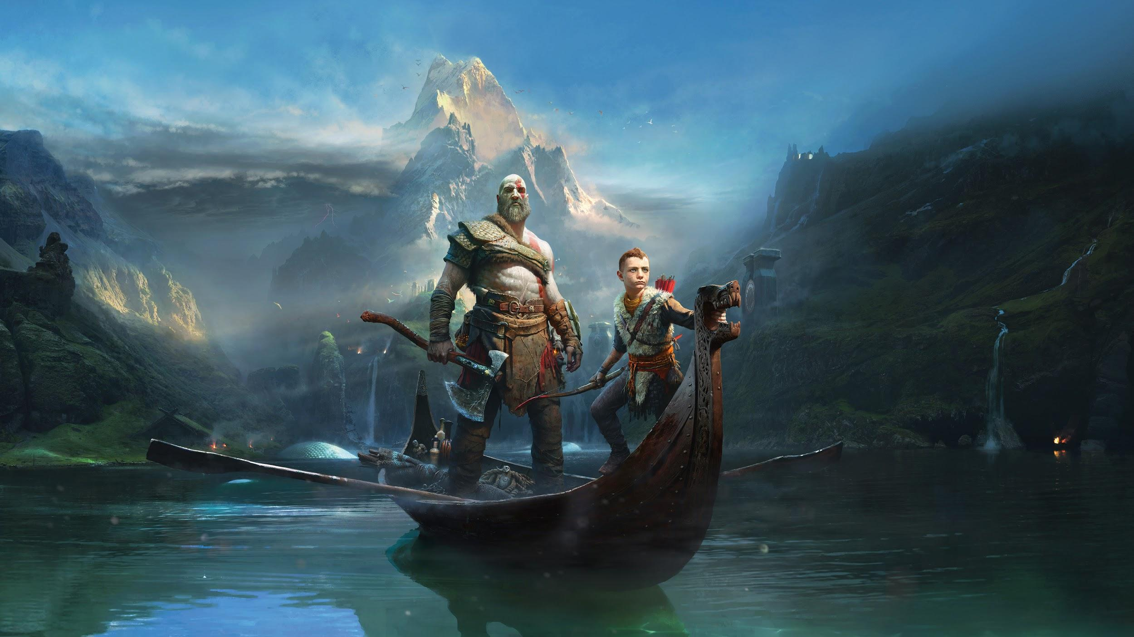
God of War(2018): Adaptation of Norse mythology

Slide 2
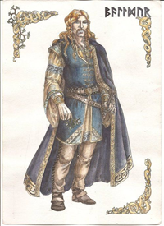
Bauldur
Baldur is sometimes depicted as being passive kind spirit but also a warlike god
Baldur dreams of his death
Freya asks everything in creation to swear not harm him (forgetting to ask mistletoe).
The gods amused themselves by throwing all sorts of weapons at Bauldur because of his invincibility when Loki gives The blind god Hodr a mistletoe tipped weapon killing Bauldur instantly. Starting Ragnarök.

Slide 3
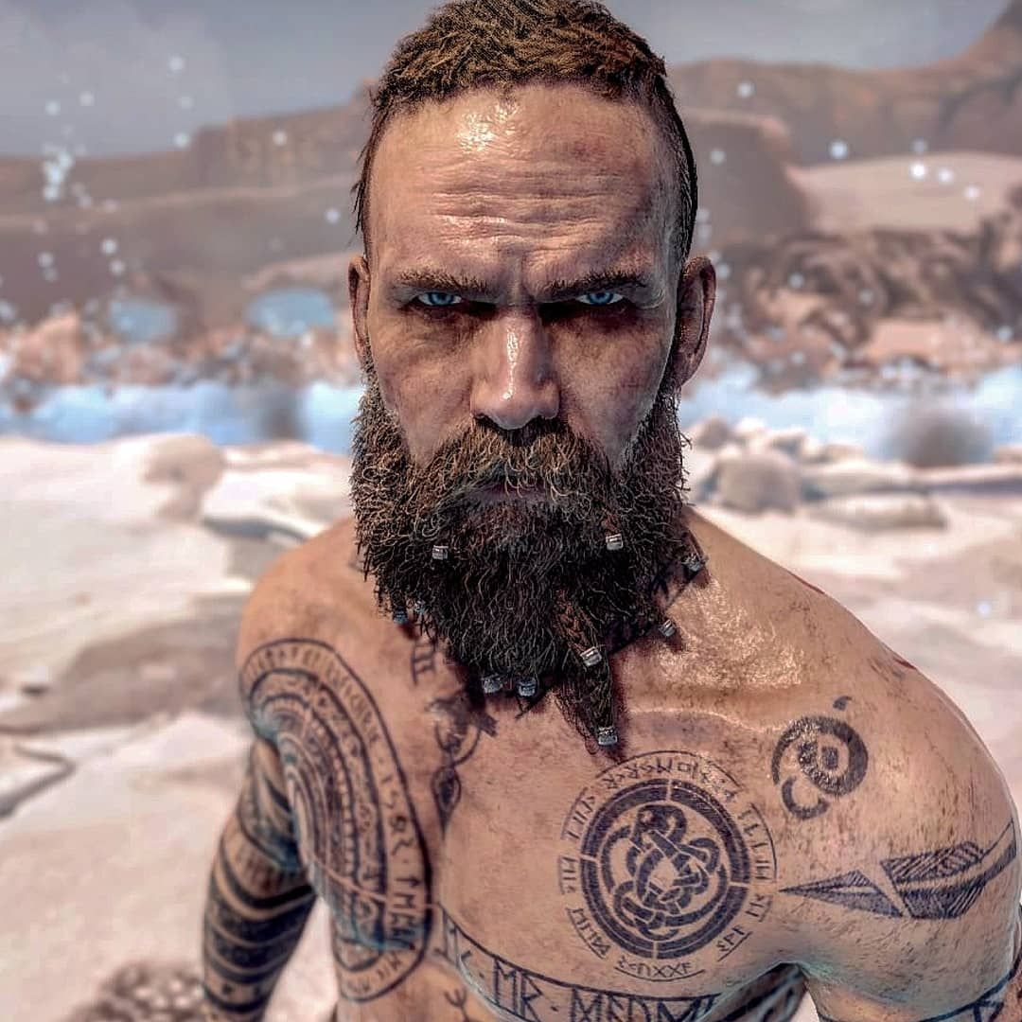
Bauldur (Game)
Freya learns from runes that he would die
Freya places a spell on him which making him invincible to everything with mistletoe being the only thing that could break the spell.
The spell had the side effect of making him not being able to feel anything, driving him to insanity .
After being tasked by Odin to kill the last of the giant, confusing Kratos for his dead wife and trying to kill him throughout the game, the spell get broken after hitting Atreus’s arrowhead which is made of mistletoe and is killed by Kratos After refusing to spare his mother for cursing him. Starting Ragnarök.

Slide 4
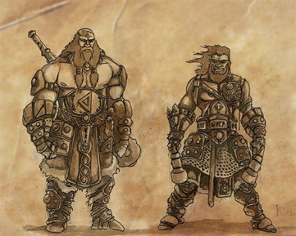
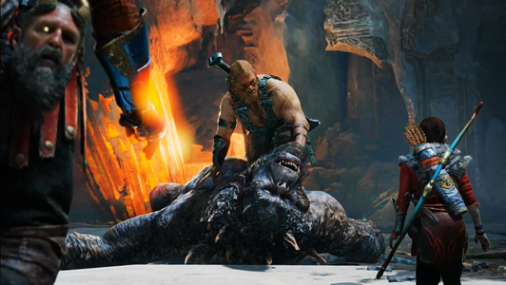
Modi and Magni(Myth)
The sons of Thor will both survive Ragnarök and shall inherit Thor’s hammer Mjolnir.
Their names mean Wrath and Mighty and are meant to represent two of their father most known features.
The sons of Thor are two of the Bosses in the game who both do not survive before Ragnarök.
They act childishly rude with Modi being killed by an increasingly arrogant Atreus after making a your mom joke.

Slide 5
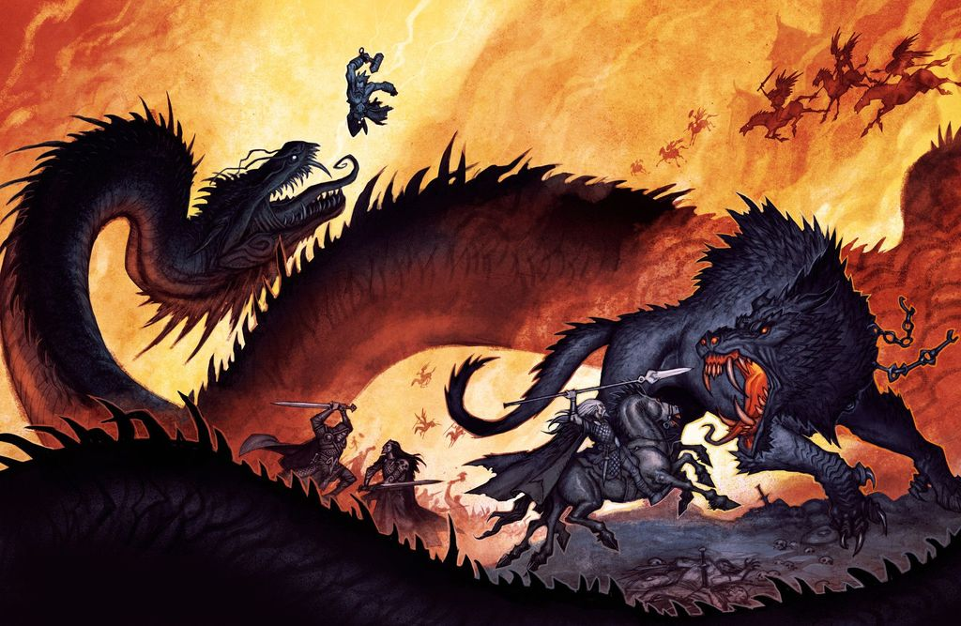
Ragnarök(Fate of the gods)
•Ragnarök is a series of events predicted by a seer(someone who can see the future) which leads to the end of the Aesir Gods.
•Ragnarök is set into motion with the death of Baldur followed by three long years of winter and war then the sky sun and moon shall disappear
•A red rooster shall notify Heimdall that ragnarok has begun, all the dead from Valhalla (the dead who died honourably) and the dead from Hel(those who did not) shall pick up arms and fight on the side of the Aesir or the Giants respectively.
•Odin, Thor, Loki, Heimdall, Tyr and Freyr all shall perish before the end of Ragnarök and the world shall be submerged in water and begin a new.

Slide 6
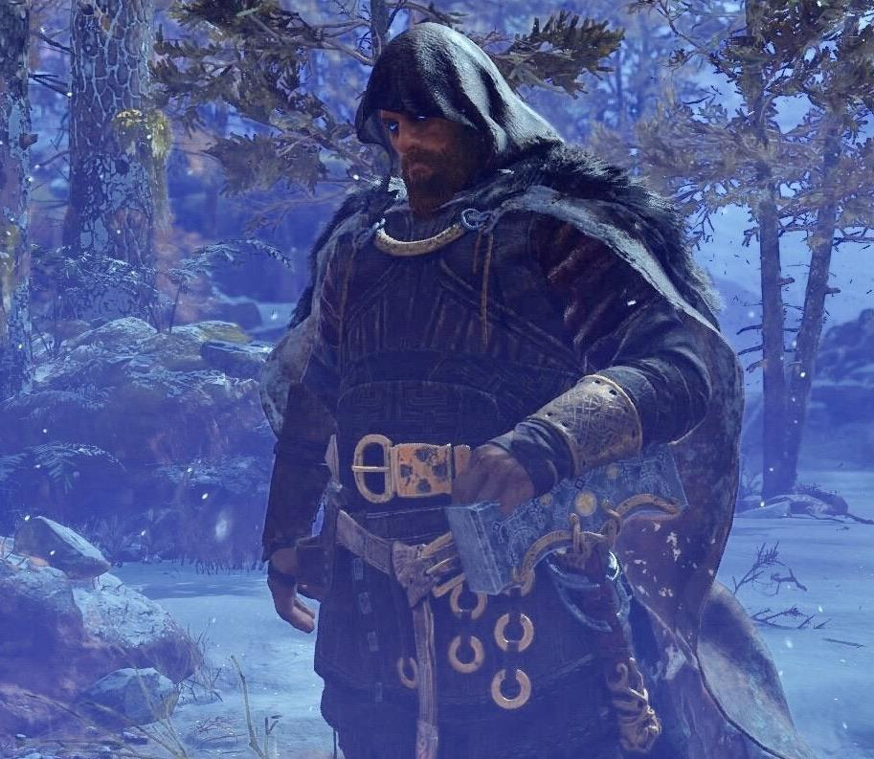
Ragnarök(God of War style)
•Jormungandr will be hit so hard by Thor that the World serpent shall be sent back in time so the version in the game is a future version shown by his clear hatred of Thor in the game and the fact that he exist in the present as Loki(Atreus) is his father.
•According to Mimir Odin only has pieces of the prophecy and is aware that Kratos has a part to play in Ragnarök but not sure what leading him to fear Kratos.
• The end of the game shows the giants prophecy which shows everything that happened in the game and some future events such as Kratos dying with Atreus holding him in his arms while a young Jormungandr is released from Atreus’s mouth.
•The Hidden ending shows that after three winters have passed Thor shows up to confront Kratos as Ragnarök has begun

